Slide 1

Cats With Braces
Brian, Glenn, John & Tamara

Slide 2
Presentation overview
About
Tasks
Revised interface design
Prototype overview

Slide 3
Value proposition Bespoke language learning that focuses on your personal language needs, interests and convenience (location)
Problem Existing language learning apps don’t offer the necessary conditions for successful language learning to occur, such as real-life practice, learning through topics we really care about and interacting with others in a “similar boat”
Solution Identify and address these conditions through app features: introduce opportunity for real-life practice with individuals with similar interests and language learning needs for a unique user-tailored experience

Slide 4
Task 1 (simple) Have a real-time voice conversation with someone in a foreign language
Task 2 (moderate) Meet people nearby with similar interests and complementary language needs
-slightly tweaked: less specific - no more ranking of language expertise
Task 3 (complex) Allow users to learn context-specific and interest-related vocabulary in real time
-slightly tweaked: now just interest-related, but high fidelity version might suggest vocabulary specific to context/previous interactions (privacy issue?)

Slide 5
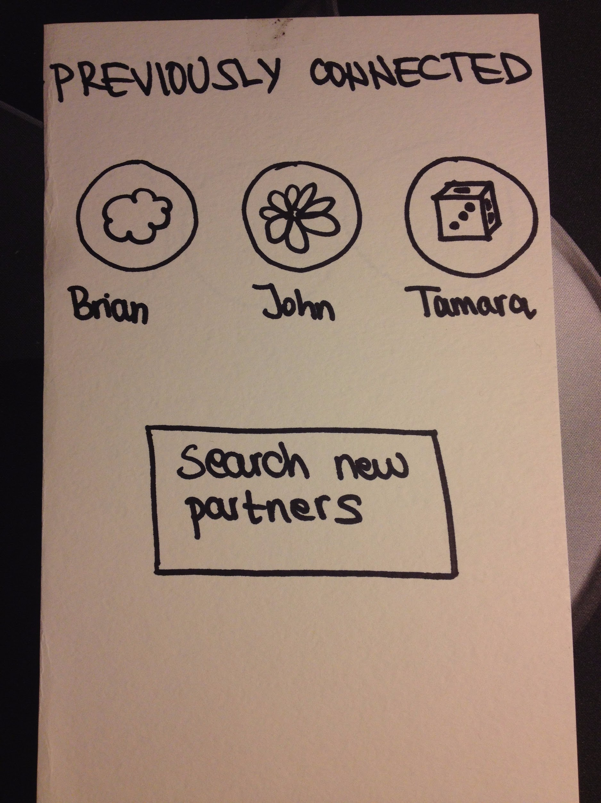
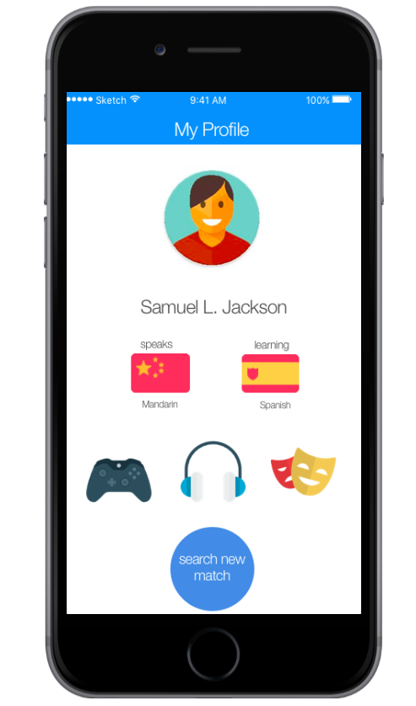
Major Change 1: Home Screen
→ human avatar to match social app standards and seem more friendly
→ more clear (shapes of icons not confused with buttons)
→ information is equally distributed (no huge avatar), no emphasis on previous connections
→ match, not partner

Slide 6
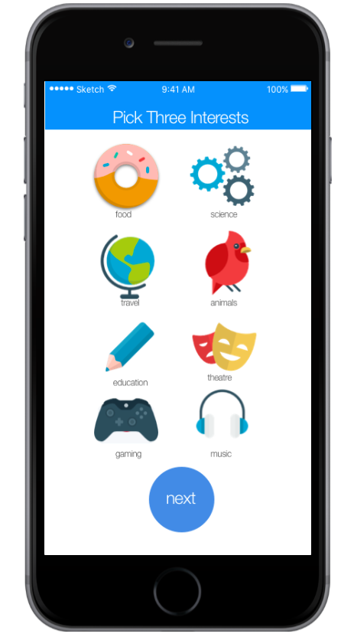
Major Change 2: Onboarding
→ important: reduces confusion about interests
→ people now get the point that icons are criteria for matching
→ improves ease of use
X

Slide 7
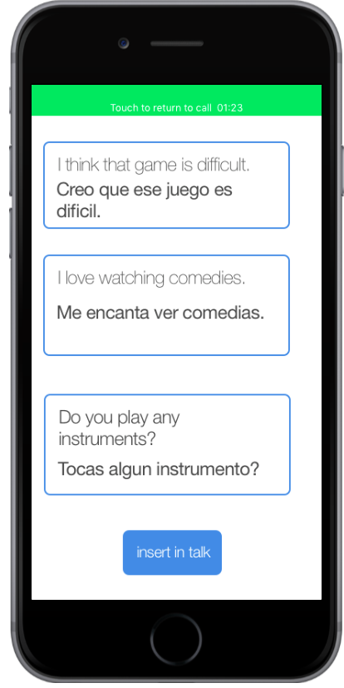
Major Change 3: Suggested Phrases/Translate Interface
→ more phrases, and more specific
→ now phrases can easily be embedded directly in convo
→ more convenient - just a click away
→ eliminates need to look back and copy from memory
→ advanced opportunities(changes based on previously used)

Slide 8
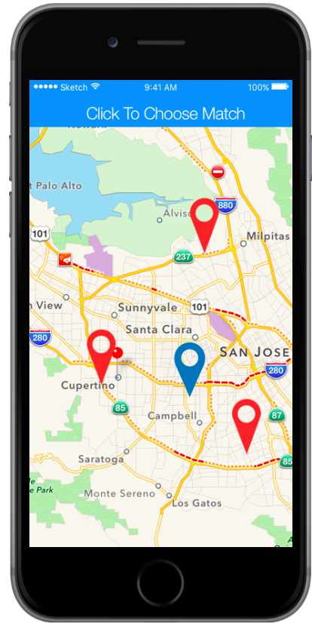
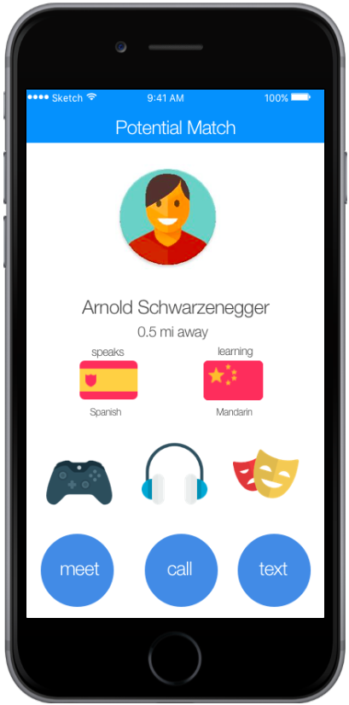
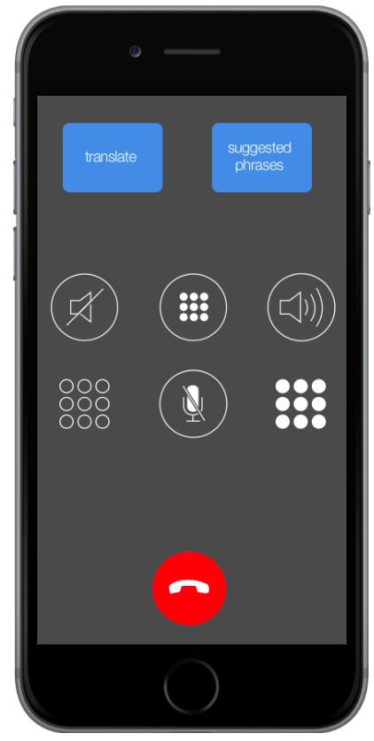
Task Flow 1: Real-time voice conversation in foreign language
Click on partner
Select Call
Home
search match
Task done!

Slide 9
Task Flow 2: Meet people with similar interests & needs
Home
search match
Click on partner
Select Meet

Slide 10
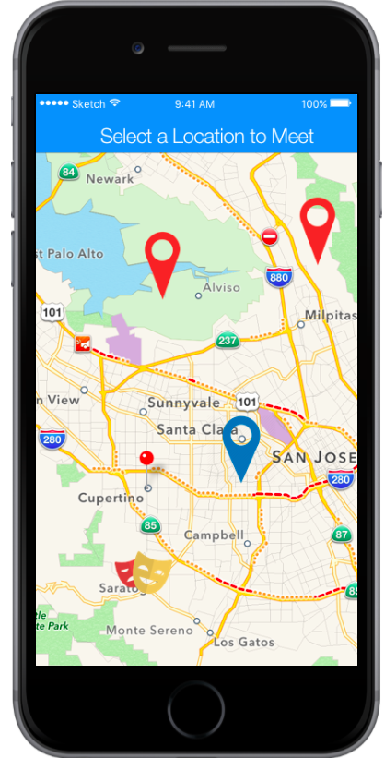
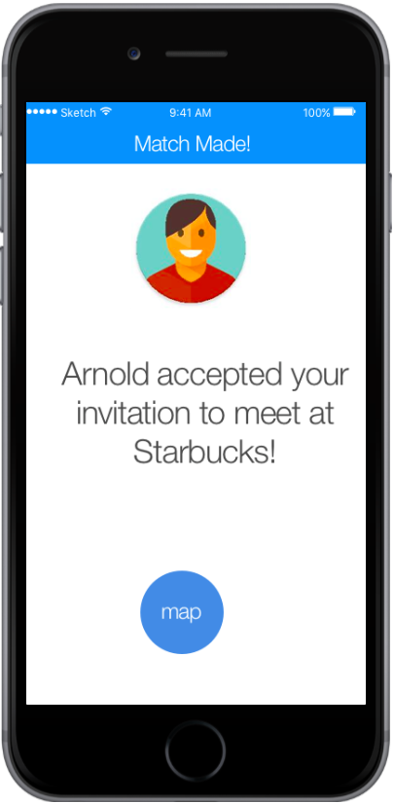
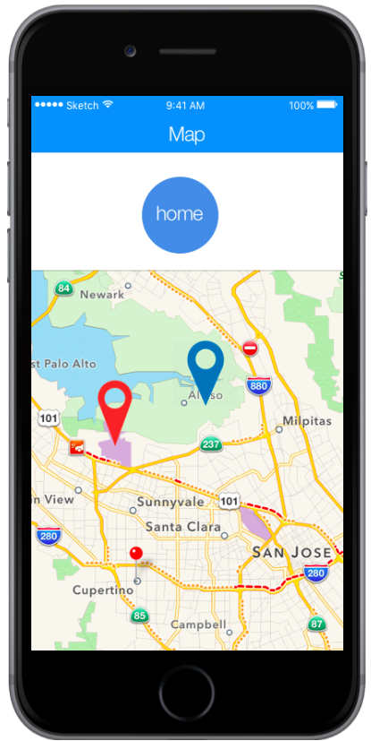
Task Flow 2: Meet people with similar interests & needs
Select location to request meetup
Get notified of acceptance
Find partner on map

Slide 11
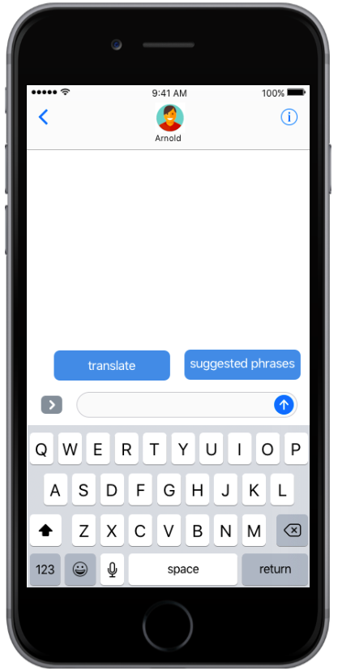
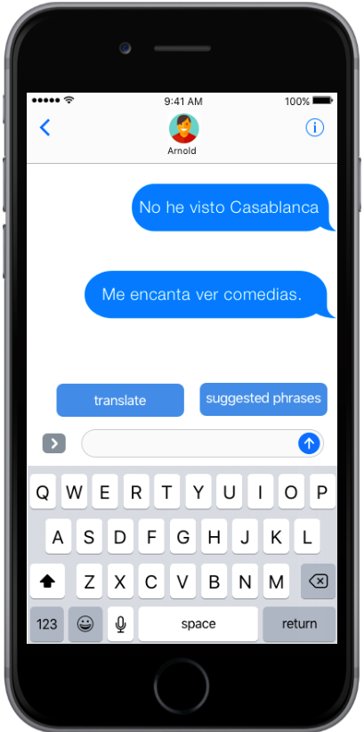
Task Flow 3: Learn interest-related phrases and new words as you need them
Go to Suggested Phrases
Select a phrase
Insert in talk
Home
Select Text
Good job!

Slide 12


Prototyping Tools: Sketch & Marvel
HELPFUL
Easy and quick to learn, clean interface
Gives fast and realistic results
Useful iOS UI templates and plugins for different designs
Ability to design directly on a screen of choice
Made us aware of the need for being specific and clear when coming up with user flow
UNHELPFUL
No interactivity – could only make screens but not entire flow
Some plug-ins were difficult to insert
Didn’t support ai files so had to convert to .jpg
HELPFUL:animation/transitions
UNHELPFUL: design itself

Slide 13
Limitations & Tradeoffs
- no more avatars until we find more gender/racially neutral or appropriate ones
- still no definitive icons (e.g. location)
- left out some languages/interests for the purpose of simplicity
- content is static (no scroll)
- shows only one user’s version (what if someone requests you?)
- no online/offline switch

Slide 14
Limitations & Tradeoffs
- didn’t perfect the flow of all screens (e.g. what happens when we want to end call but keep messaging with someone)
- no Wizard of Oz techniques
- a lot of hard coding (user interests, conversations, languages) - needed because we wanted to show user interactions but didn’t have any actual information so we “customized” by hard coding ourselves

Slide 15
Thank you!

